Slide 1
HR Management Tool
One Stop Solution for all your HR Needs.

Slide 2
About HR Tool
HR Management tool has been developed by group 22 for the DBMS Project. It has all the required features, such as, maintaining employee record, generating paychecks, adding incentive, adding leaves and viewing and searching employee profiles.
It also features separate admin logins and employee logins to give admins the extra features which can’t be accessed by regular employees.

Slide 3
Objectives of our Project :
1.) Hierarchical framework of organisation
2.) Employee search with filters
3.) Communication between employee and admin
4.) Payroll generation

Slide 4
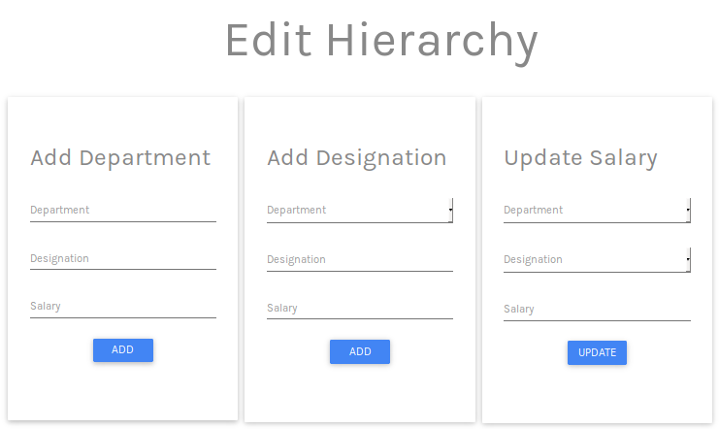
Hierarchical Framework :

Slide 5
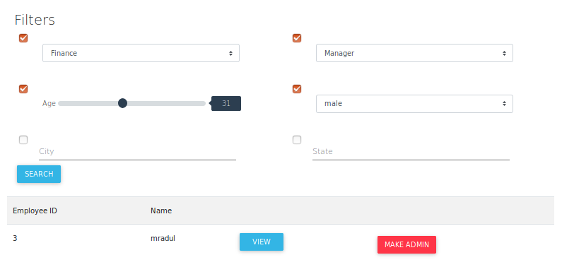
Employee Search :

Slide 6
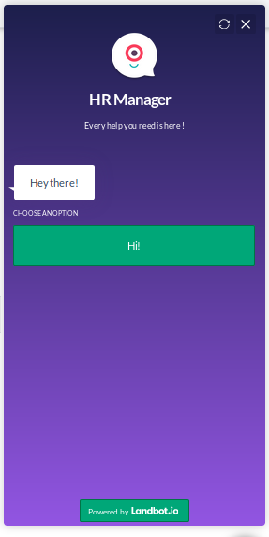
Employee Admin Communication :

Slide 7
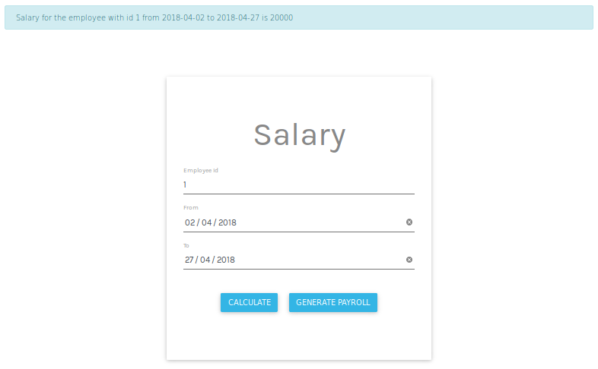
Payroll Generation :

Slide 8
Technologies Used :
CSS
Flask
MySQL
HTML

Slide 9
Tables Used :
Attendance
City_State
Employee
Incentive
Salary
State_Nation

Slide 10
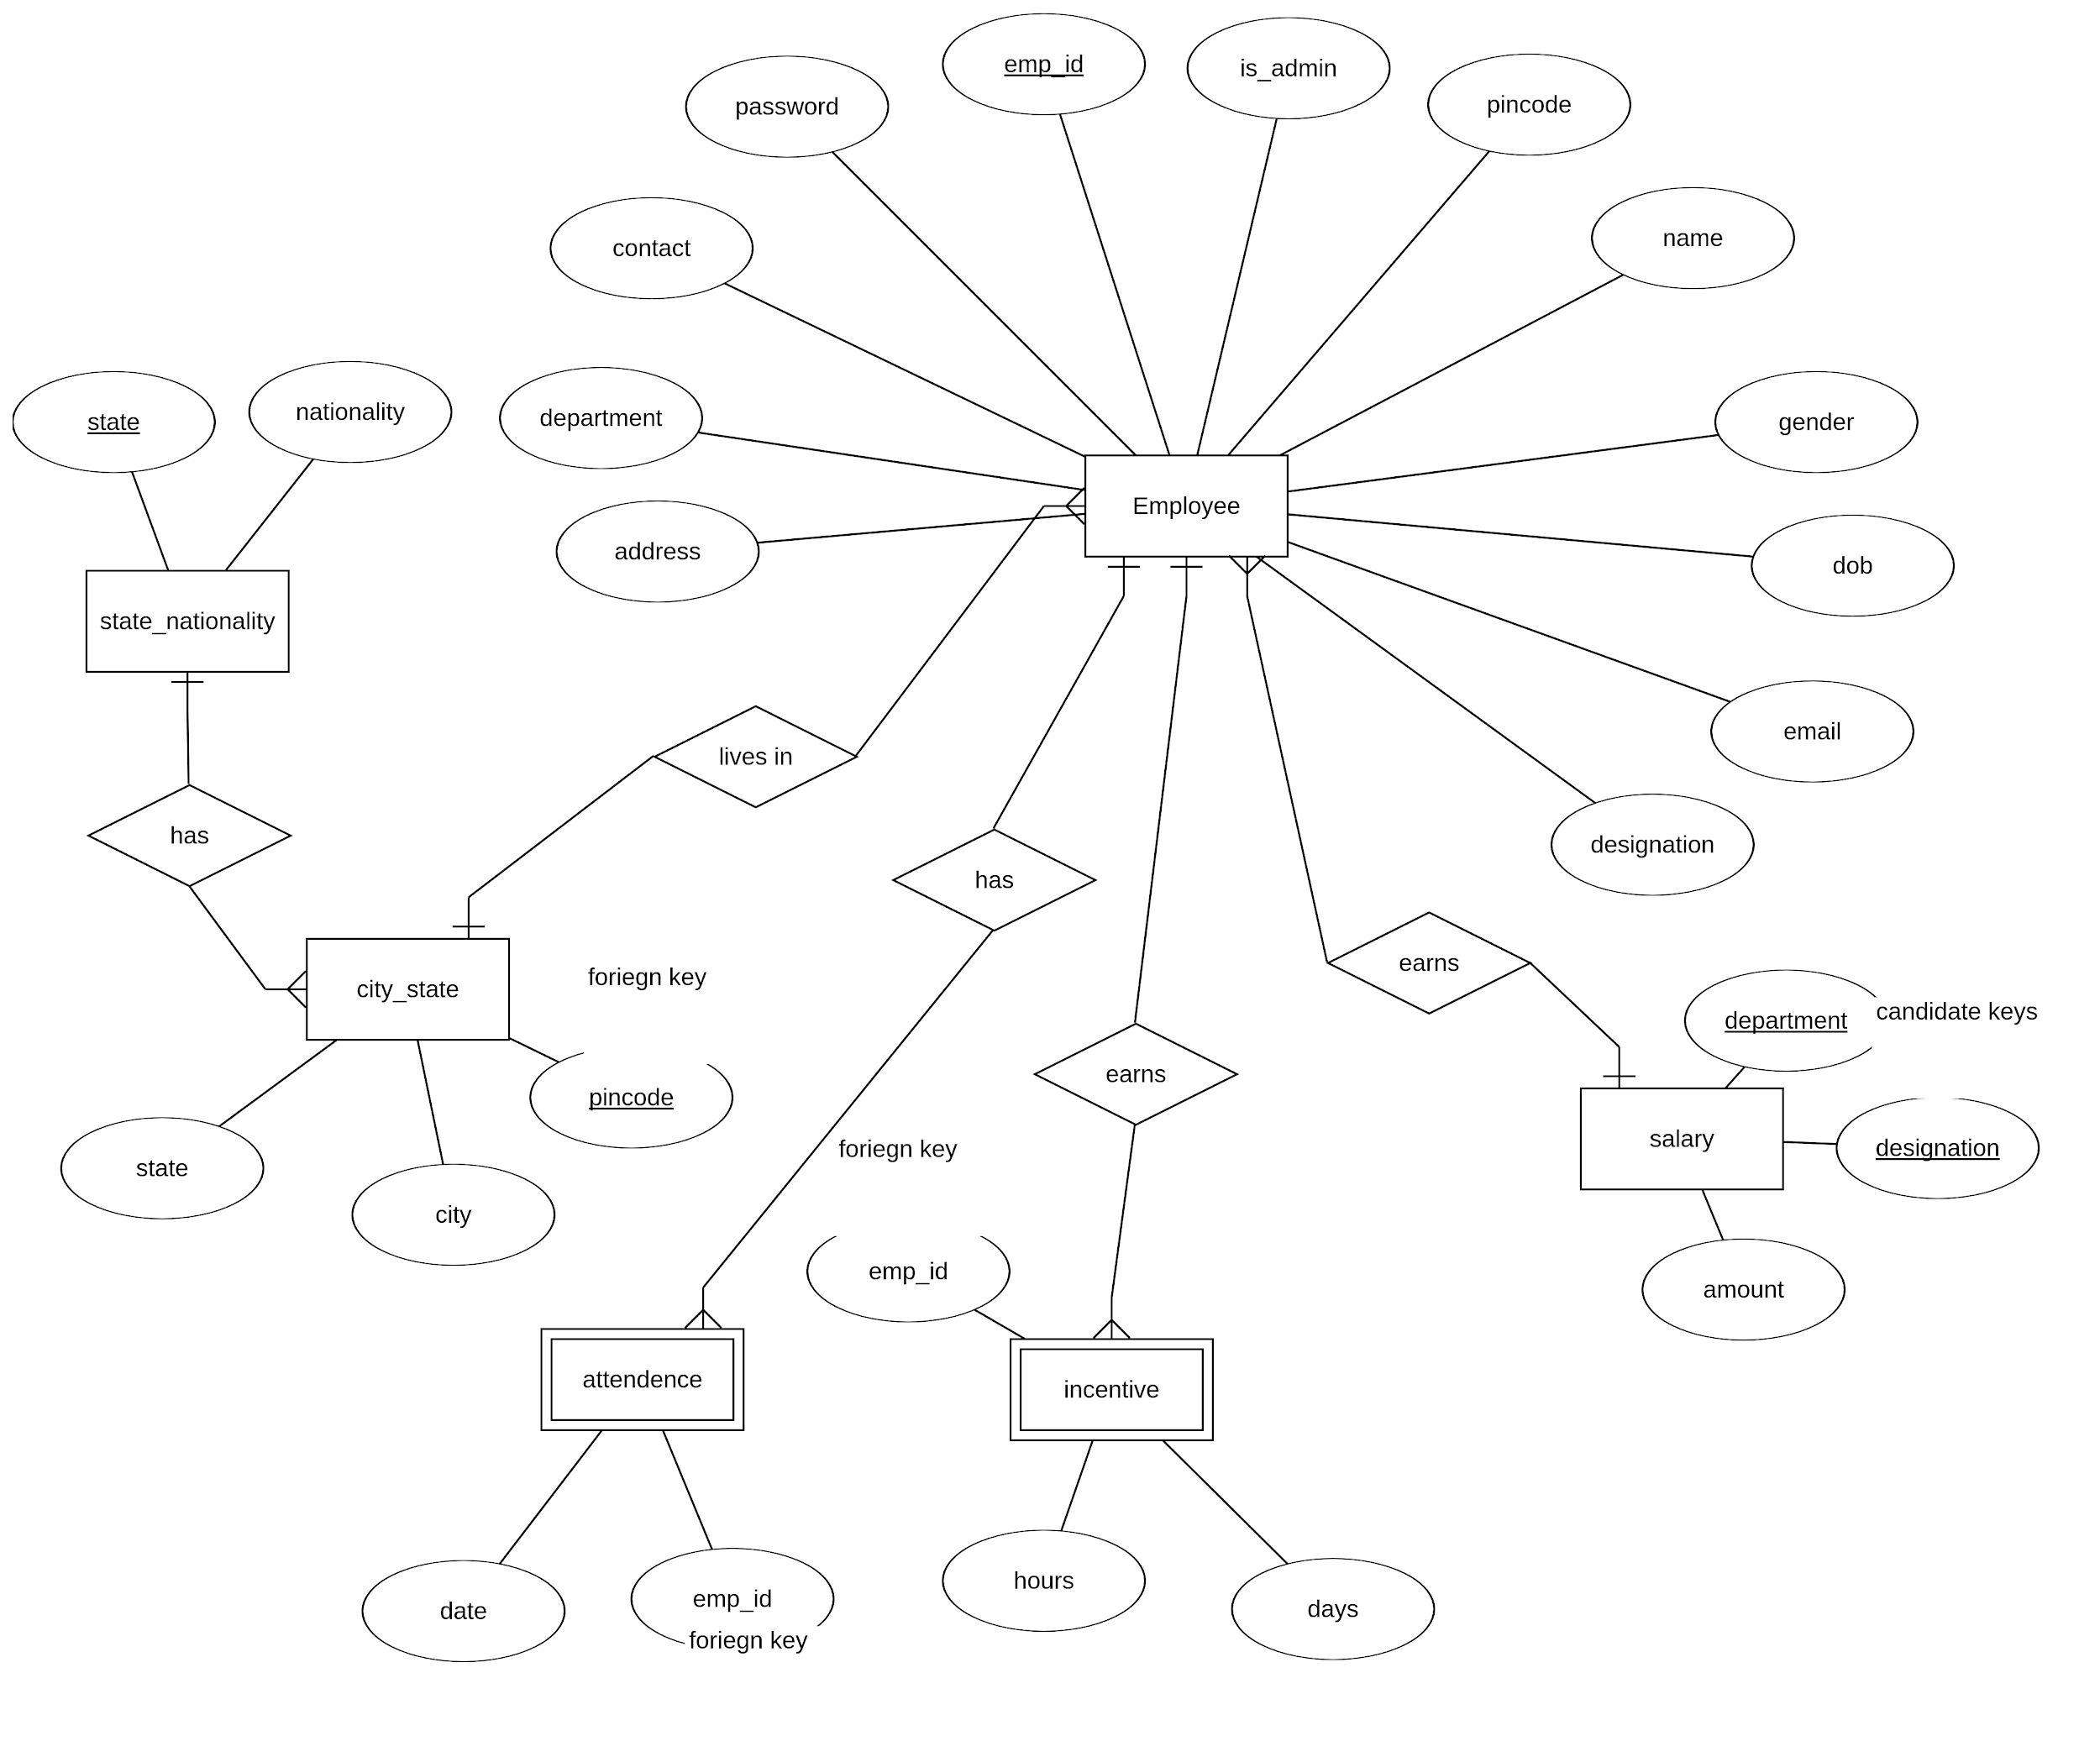
ER Diagram :

Slide 11
About our Database :
HR Management tool uses an efficient database with all the tables of this app following 1NF, 2NF and 3NF form. These forms reduces the time taken by a query to execute and reduces data redundancy in database and saves storage space as well without increasing the complexity of database. Thus, our app is supported by a nicely developed backend which makes it fast, efficient and reliable.

Slide 12
Project samples

Slide 13

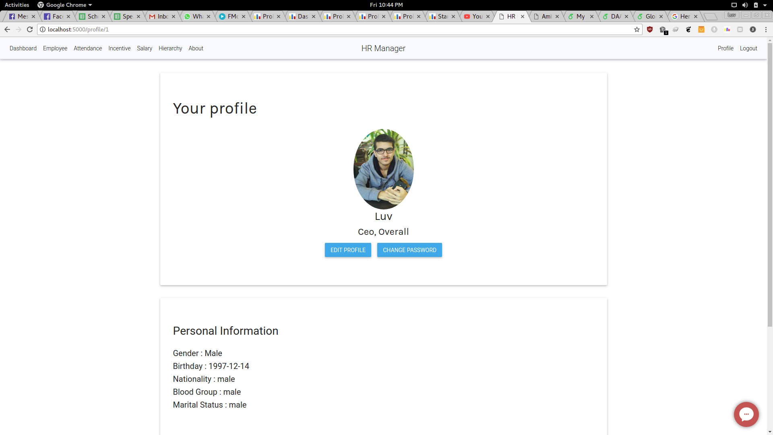
HR Tool
Featuring minimal design and only required features, this app loads seamlessly on web.

Slide 14
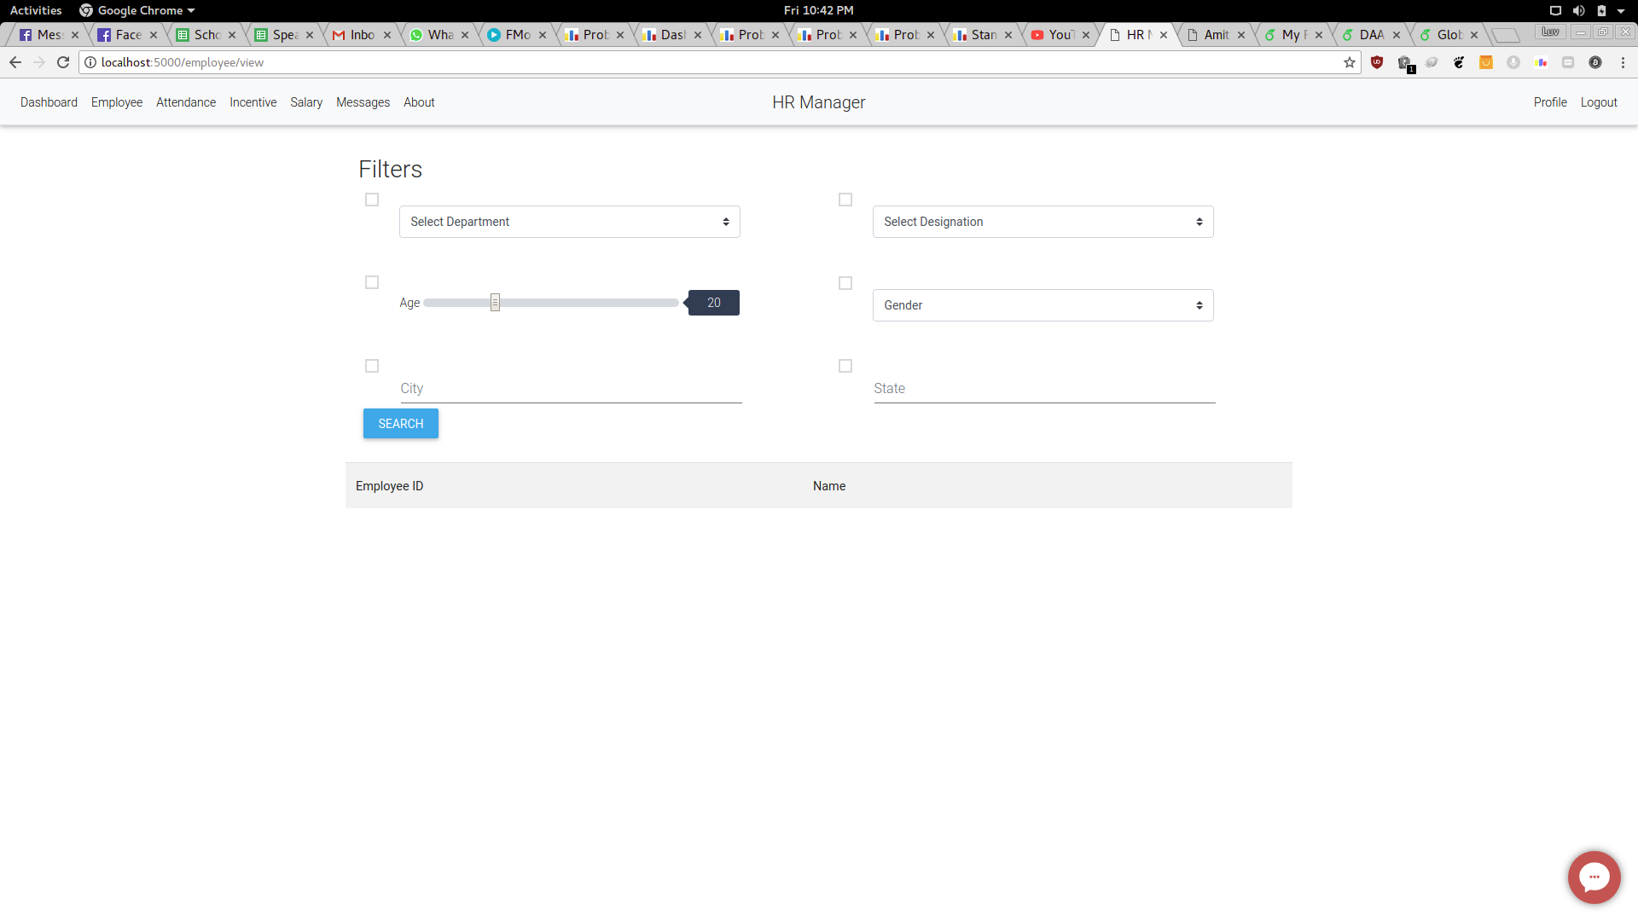
Filter Search

Slide 15
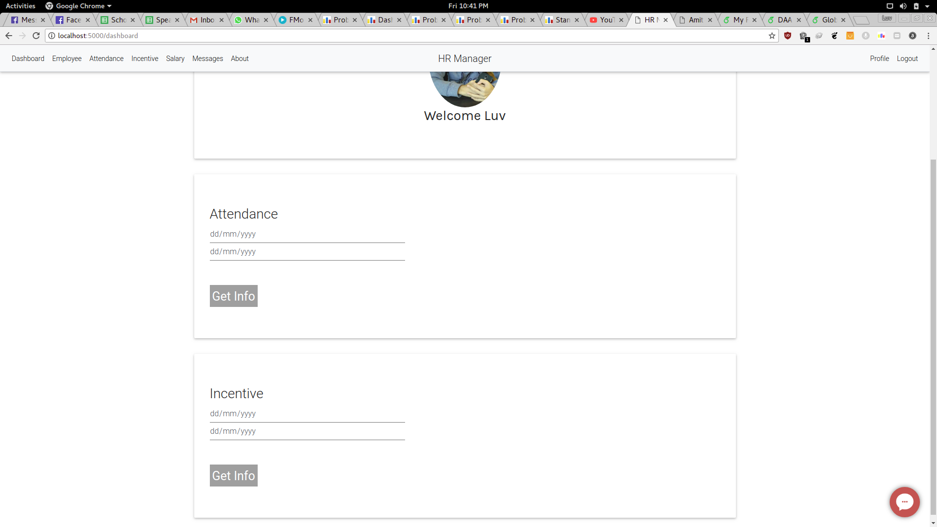
View Attendance
&
Incentive

Slide 16
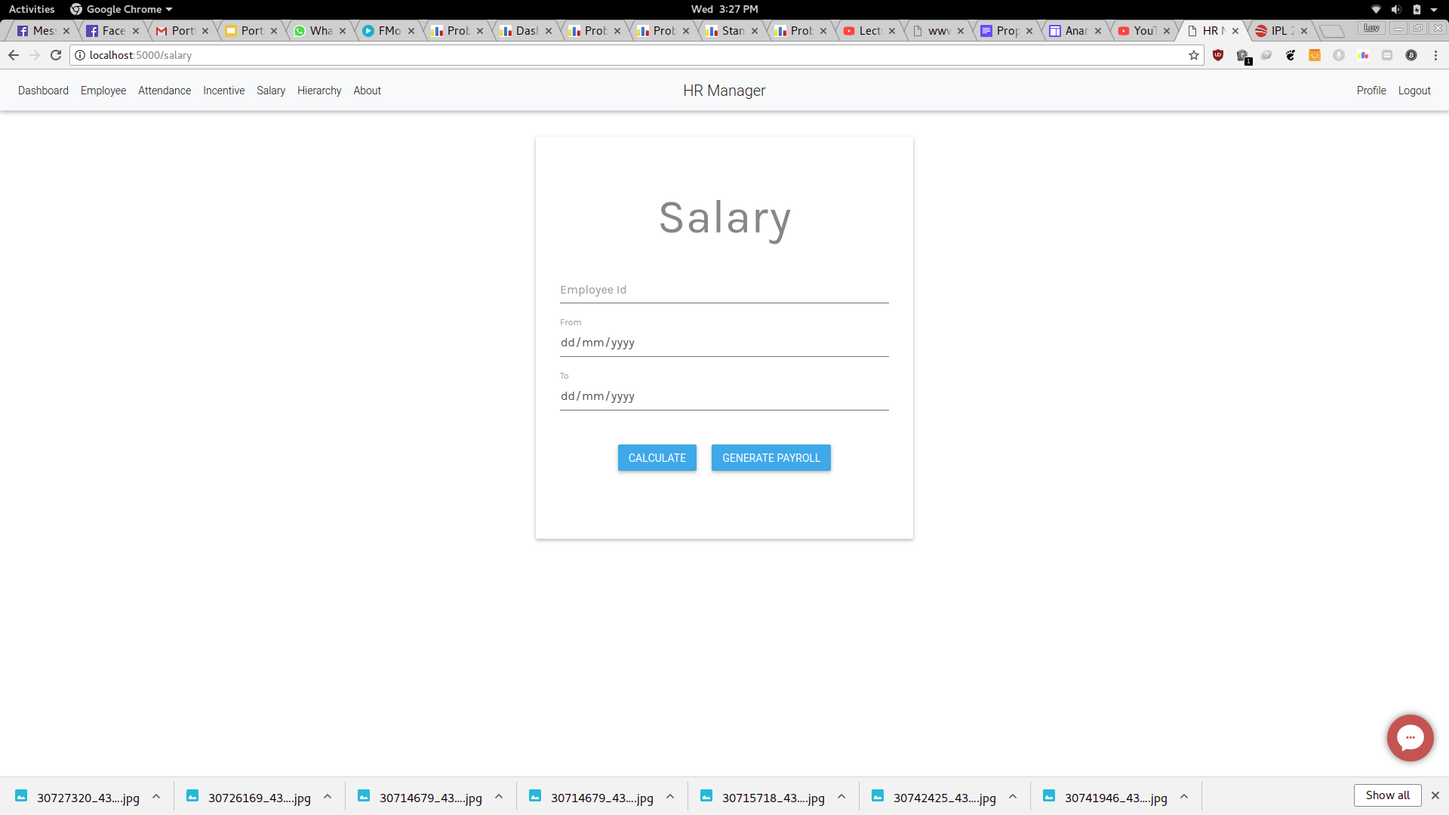
Salary/PayRoll

Slide 17
Developed By:
Group-22
Luv Kumar
IIT2016085
Pranav Mahajan
IIT2016086
Madhur Gupta
IIT2016083

